Slide 1
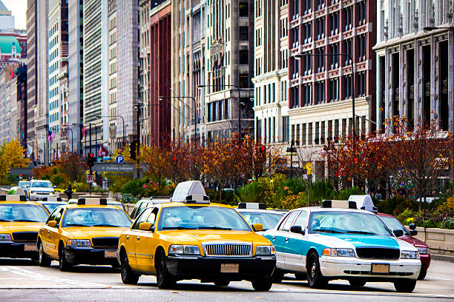
Exploratory Analysis of Chicago Taxi Rides
Database Design and Implementation
Sam Ding, Sylvia Li, Rujia Yuan

Slide 2
Project Scope
Brief
Understand the business problem and project goal
ETL Process
Database Design and ETL Process
Next-step recommendations
Recommendations
Query & Data Visualization
Finding

Slide 3
Executive Summary
Taxis in the city of Chicago are continually attracting more customers, since the prices float little and the taxis always charge fewer than the ubers/ lyfts do. However, increasing citizens complained that finding a taxi was way harder than finding an available uber/lyft.
In order to be able to quickly analyze and respond to both customers' demands and taxi drivers' supplies, we are supposed to create a data storage system to help load, store, extract and utilize data.
The data storage system will support the decision making and offer convenience for different groups – drivers, passengers, Cab Company, and the government in particular ways.
System functionality includes data cleaning process from raw data, relational database for storage and access, and visualization tools for dashboarding and presentation.

Slide 4
Business Use Case
For Driver
Less idling in Surge Zone / Peak Hour
Transform Cab booking service
Make long-distance ride more predictable
For Cab Company
Allocate Ride Reservations
Offer incentives to drivers to ensure supplies meet demands
For Passenger
Reduce the waiting time
Offer more choices at a competitive rate
For Government
Ensure Price Transparency
Adjust taxi cost and fare model
Adjust airport departure tax

Slide 5
ETL Preparation
Data Source
Taxi Trips from Chicago Data Portal
Demographic data by census tracts from census.gov
Data Tools
OpenRefine
Google Cloud
MySQL Workbench
Tableau
Design Consideration
Data Type
Use of Junction Table
Use of Fact Table and Dimension Table

Slide 6
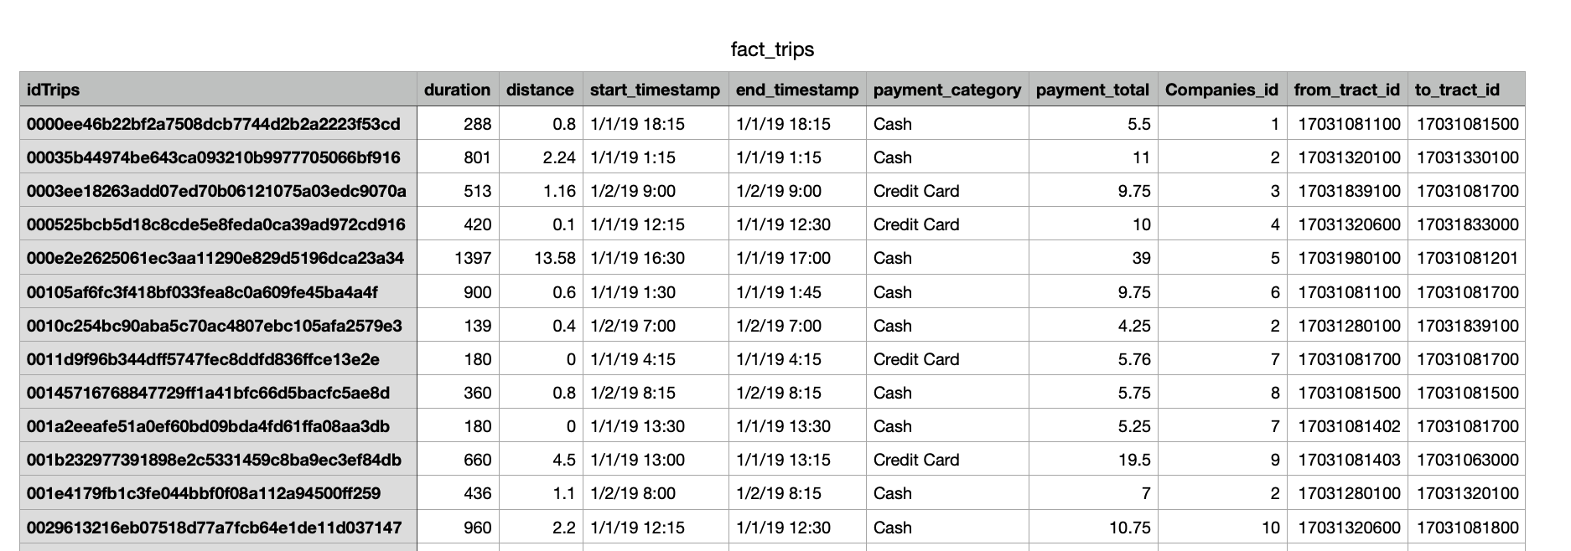
Sample 3NF+ Table (Fact_Trips)

Slide 7




ETL Process
Extract
Transform
Load
Taxi Trips 2019Q1
Chicago Metropolitan Area
Census Tract

Slide 8
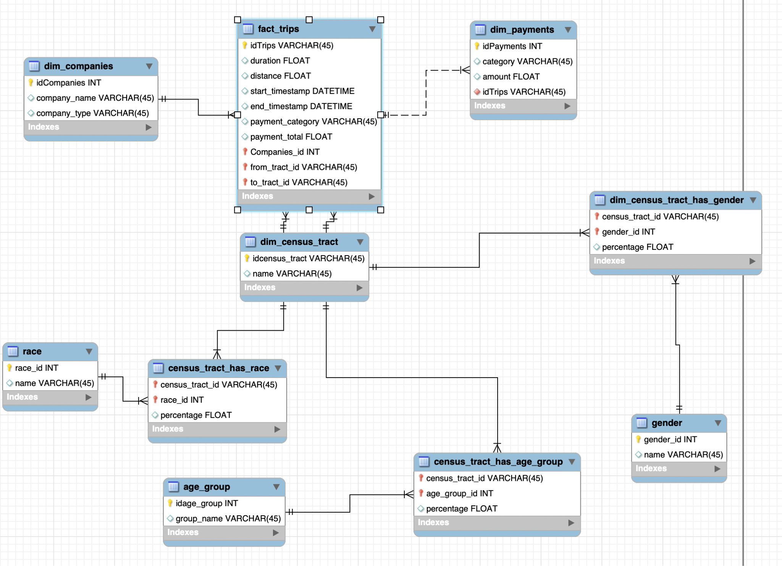
EER Diagram - Taxi

Slide 9
Query & Data Visualization

Slide 10
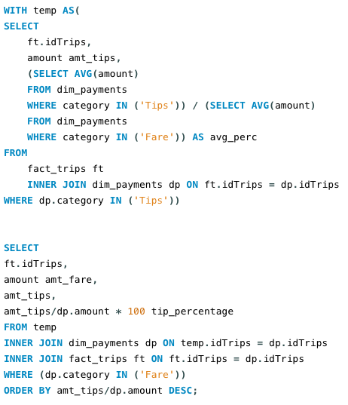
SQL Analysis Insights
We consider the business uses for our dataset, testing some possible cases through mySQL workbench.
Example: Find the percentage of tips for all customers.
Figure: Example Query
Notes:
we check the taxi company which is ordered most, the floor of the maximum, minimum and average payment total, all trips greater than and equal to $8 and Less than equal to $20, all trips which likely be taken by females (>50%percentage), and the trips with tips greater than average tips, sorted by the amount of total payments from high to low.

Slide 11
SQL Analysis Insights
Trips ID | Fare Amount | Tip Amount | Tip %
ID1 | 3.25 | 4.75 | 146.15
ID2 | 3.25 | 3 | 92.31
ID3 | 6.25 | 5 | 80
ID4 | 5.75 | 3 | 52.17
ID5 | 4 | 2 | 50
… | … | … | 11 (avg)
IDxw | 9.75 | 0 | 0
IDxx | 9 | 0 | 0
IDxy | 6.5 | 0 | 0
Higher tip percentage happens on trips that are low-priced.
A considerable amount of customers don’t tip the driver.
Average tip percentage is 11%.

Slide 12
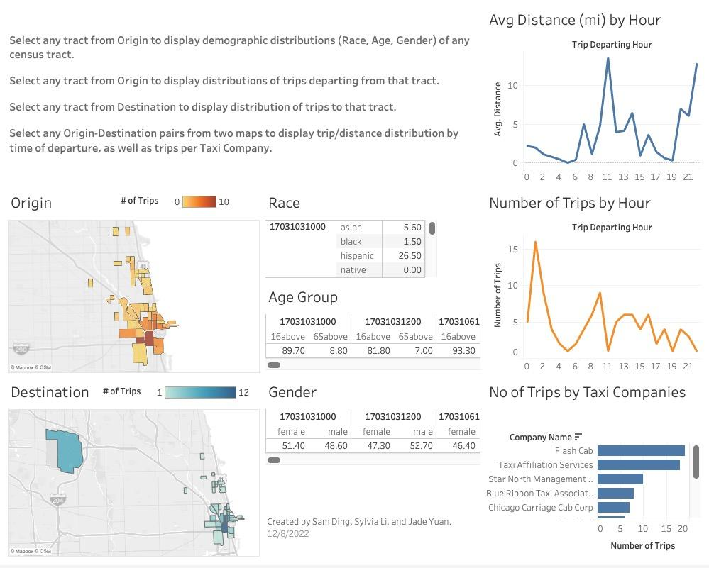
Tableau Dashboard

Slide 13
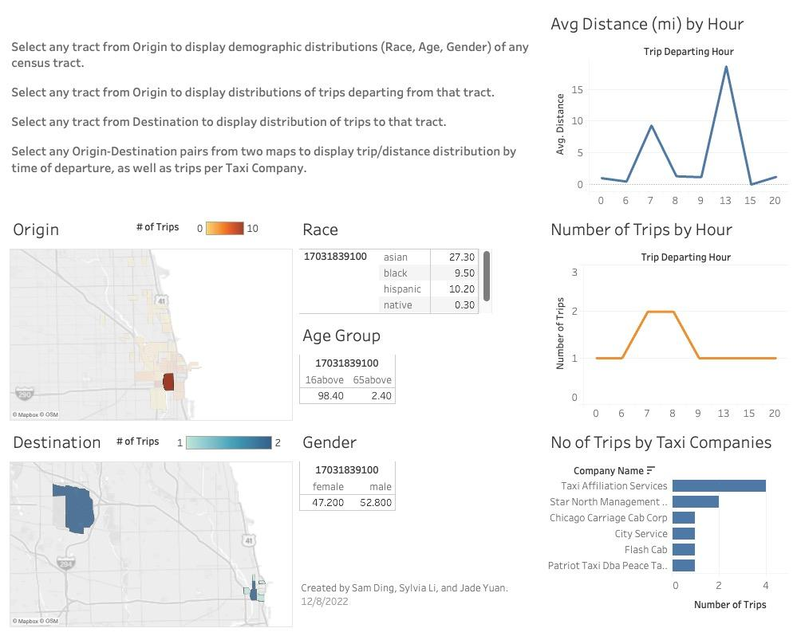
Tableau Dashboard

Slide 14
Recommendations
Adding more services to the Airport area (both ORD and MDW) in response to the high demands
Considering the demands from the elderly, adding more accessible taxi services
Encouraging the passengers to take the less representative taxi companies’ rides to ensure healthy market competition

Slide 15
Q & A

